Slide 1
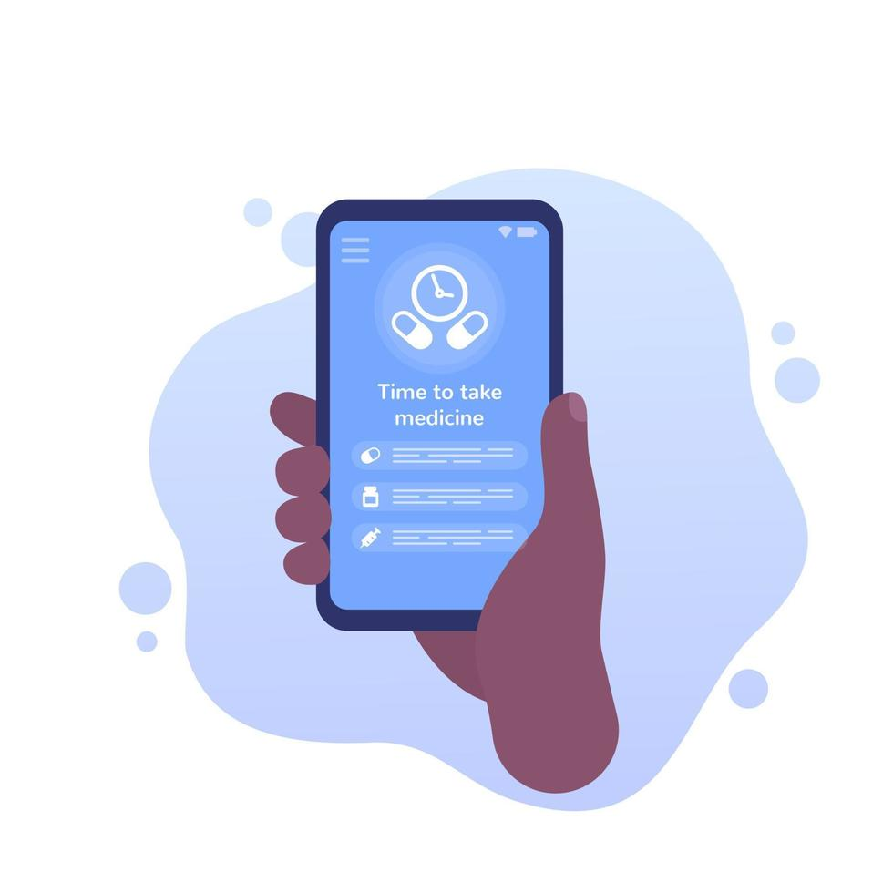

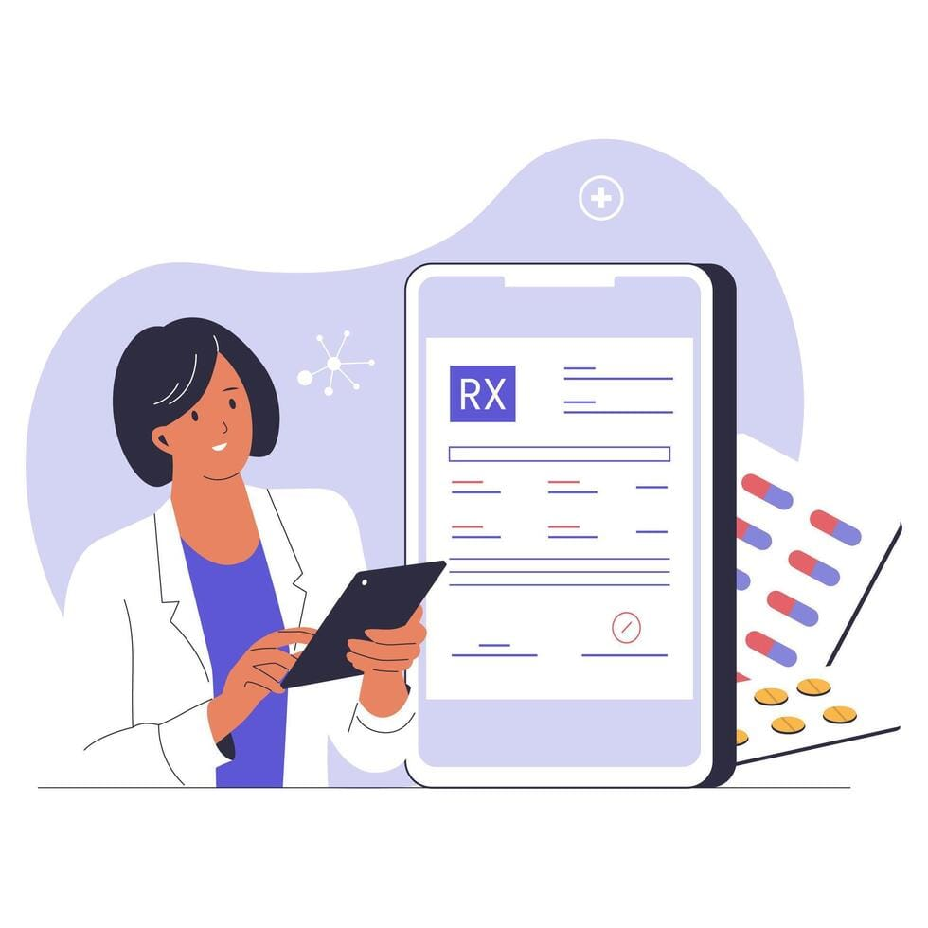

Prescripto - Online Medication and Prescription Tracker With AI-Powered Health Assistant

Slide 2
TEAM MEMBERS
NAME | ROLE
1. KHUSHI | FRONTEND
2.SHREYA | FRONTEND
3.PRIYANSH | BACKEND, AI
4.AKSHATA | BACKEND, AI
Fronten

Slide 3
INTRODUCTION
Traditional healthcare systems rely on manual prescriptions and paper records
Patients often struggle with managing medications and schedules
High risk of missed doses, errors, and lost prescriptions
Lack of efficient communication between doctors and patients
Need for a secure and centralized digital solution.

Slide 4

PROBLEM STATEMENT
Lack of structured medication tracking systems
Difficulty in maintaining and retrieving prescriptions
Limited monitoring of patient medication adherence
Communication gaps leading to incorrect dosage and misuse
No centralized and secure platform

Slide 5
OBJECTIVES OF PROJECT
Develop a centralized digital prescription system
Enable real-time medication tracking
Provide automated reminders for schedules
Improve communication between doctors and patients
Ensure secure storage and easy access to records
Increase accuracy and efficiency in healthcare

Slide 6
PROJECT DESCRIPTION
Prescripto is a digital platform for prescription and medication management
Doctors can create and manage digital prescriptions
Patients can track medications and schedules
Provides automated reminders for timely intake
Ensures secure storage of medical records
Accessible via web platforms
Includes an AI-powered health assistant for real-time guidance

Slide 7
KEY FEATURES:
Digital Prescription Management
Medication Tracking
Automated Reminders
Secure Data Storage
Role-Based Access (Doctor, Patient, Caregiver, Admin)
Prescription History
Caregiver Support
AI Health Assistant (Chatbot)

Slide 8
EXISTING SYSTEM VS PROPOSED SYSTEM:
Existing System | Proposed System (Prescripto)
Paper-based prescriptions | Digital prescription system
Manual reminders | Automated notifications
Risk of loss or damage | Secure cloud storage
No medication tracking | Real-time medication tracking
Difficult record retrieval | Easy access to history

Slide 9
SCOPE OF PROJECT
Role-based access implementation
Digital prescription creation and management
Patient dashboard for medication tracking
Reminder notification system
Secure database with encryption
Basic analytics for prescriptions

Slide 10
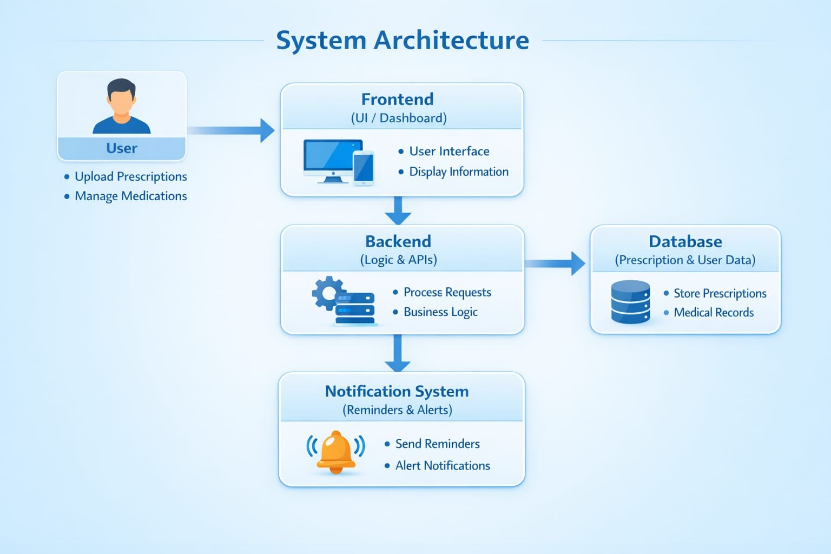
SYSTEM ARCHITECTURE:

Slide 11
AI Module Overview
Integrated AI Health Assistant using Google Gemini API
Provides real-time health-related responses
Helps users with medicine information and side effects
Enhances user experience with smart assistance

Slide 12
AI Features
AI chatbot for instant responses
Medicine usage and dosage information
Side effects query handling
Health tips and basic guidance
Quick suggestion buttons
Floating chat interface

Slide 13





TECH STACK USED:
Frontend: HTML, CSS, JavaScript / React
Backend: Java 17, SpringBoot
Database: MySQL
AI Integration: Google Gemini API (2.5-Flash)
Authentication: JWT Authentication

Slide 14
TARGET USERS
Doctors: Create and manage prescriptions, monitor patients
Patients: Track medications, receive reminders, view history
Caregivers: Assist patients, monitor schedules
Admin: Manage users, monitor system, handle complaints

Slide 15
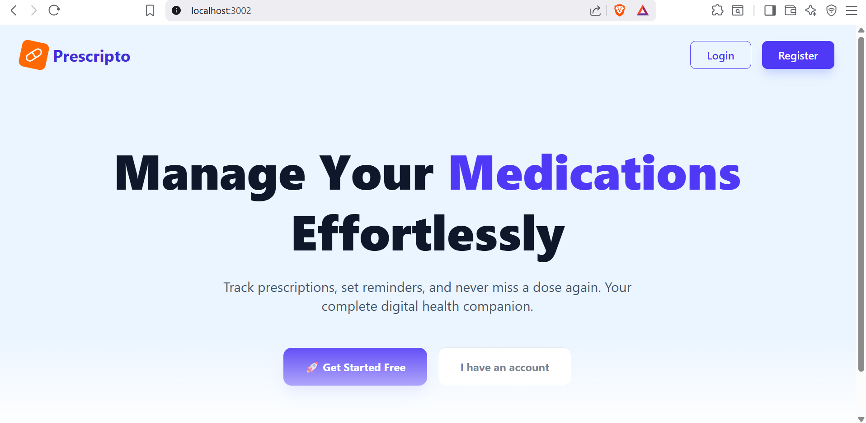
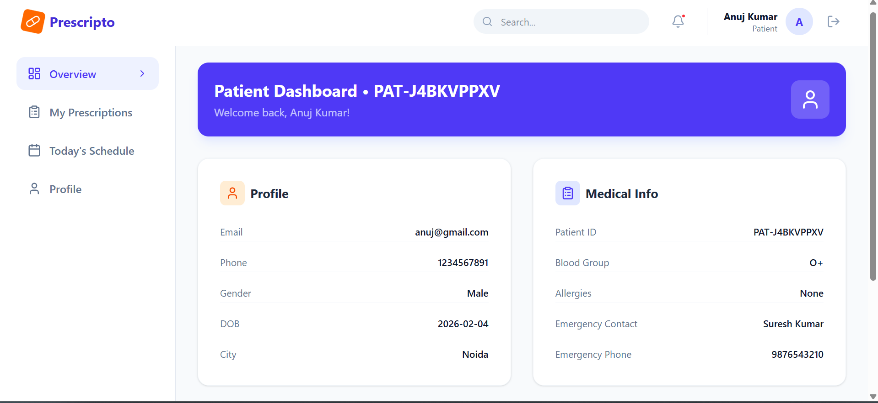
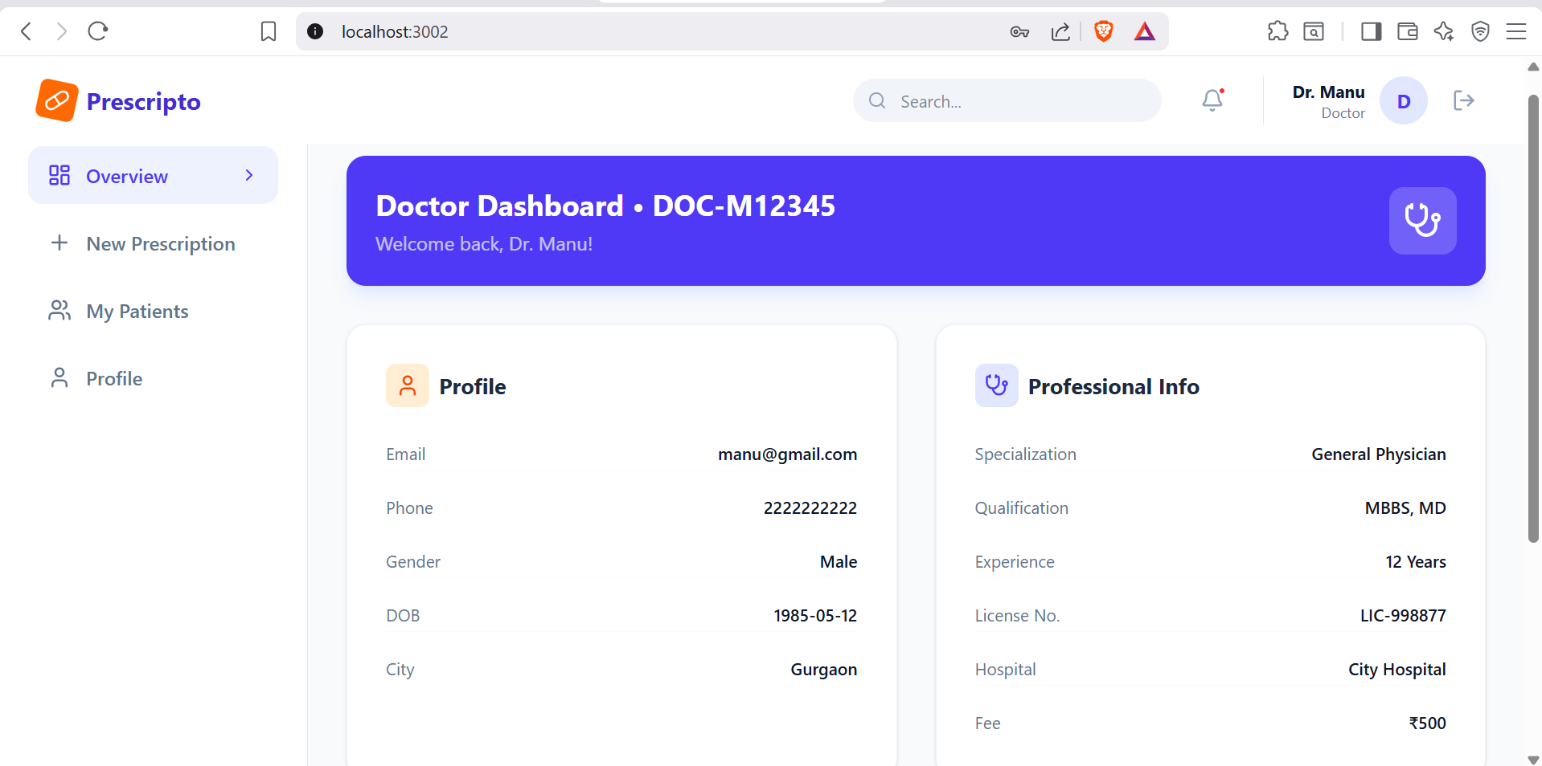
IMPLEMENTATION AND RESULT

Slide 16

ADVANTAGES:
Reduces medication errors
Improves patient adherence
Easy access to prescription history
Secure and centralized data storage
Enhances communication between users
Supports caregivers effectively
Provides AI-based instant assistance
Enables efficient system monitoring (Admin)

Slide 17

FUTURE SCOPE
Mobile application integration
Advanced AI for personalized recommendations
Integration with pharmacy systems
Wearable device support
Multi-language support
Cloud-based scalability

Slide 18

CONCLUSION:
Prescripto provides a secure and efficient digital prescription system
Reduces medication errors and improves patient safety
Enables real-time medication tracking
Enhances communication between users
Ensures safe storage and easy access to medical records
Improves overall healthcare efficiency

Slide 19
THANK YOU!!

